Slide 1
Java Fundamentals
ESSENTIAL READING:
Herbert Schildt, Java The Complete Reference, Ninth Edition, McGraw-Hill Education, 2014
SUPPLEMENTARY READING:
E. Balagurusamy, Programming with Java, Tata McGraw-Hill Education India, 2014
The Java Tutorials: http://docs.oracle.com/javase/tutorial/

Slide 2
Unit 1
Features of Java
Java programming format
Java Tokens
Java Statements
Java Data Types
Typecasting
Arrays
Class, Object, Static Keywords, Constructors, this Key Word, Inheritance, super Key Word, Polymorphism (overloading and overriding), Abstraction, Encapsulation, Abstract Classes
String Manipulations: String class, String Buffer class
Wrapper Classes: Introduction, Byte, Short, Integer, Long, Float, Double, Character, Boolean classes.

Slide 3
JAVA Overview
Java is a platform independent object oriented programming language driven by two fundamental reason
  To adapt to changing environment and uses
    By the end of 1980’s and early 1990’s object oriented programming through c++ took hold, within a few year World Wide Web and Internet would reach critical mass
  To implement refinement and improvements in the art of programming
    Even though c++ was a language that could be used to create a wide range of programs, it has some drawbacks.

Slide 4
History of JAVA
Electronic consumer devices
Sun Commissioned “ Project Green”
Developed language “Oak “ later renamed to Java
Was dismissed as just another OO programming language
Became popular with the rising popularity of “www”

Slide 5
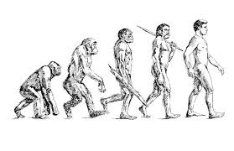
Evolution of JAVA - History
Version | Year | Key Highlights
Java 1.0 | 1996 | First public release, Applets, JVM concept
Java 1.1 | 1997 | Event model, JDBC, RMI
Java 2 (J2SE 1.2) | 1998 | Swing GUI, Collections Framework
Java 5 | 2004 | Generics, Annotations, Enhanced for-loop, Autoboxing
Java 6 | 2006 | Performance improvements, Web Services support
Java 7 | 2011 | Try-with-resources, Diamond Operator, NIO.2
Java 8 | 2014 | Lambda Expressions, Streams API, Date-Time API
Java 9 | 2017 | Module System (Project Jigsaw)
Java 11 (LTS) | 2018 | New HTTP Client, Long-Term Support
Java 17 (LTS) | 2021 | Sealed Classes, Pattern Matching improvements
Java 21 (LTS) | 2023 | Virtual Threads, Record Patterns, Structured Concurrency
Java 25 (LTS) | 2025 | Latest LTS release with continued performance, security and language enhancements
Java's Journey:
250 Classes (Java 1.0) → 500 → 2300 → 3500+ → Thousands of APIs, Cloud-Native Development, Microservices, AI Integration, and High-Performance Enterprise Applications
From Applets in 1996 to Cloud, AI, and Virtual Threads in Java 25, Java remains one of the world's most widely used programming platforms.

Slide 6
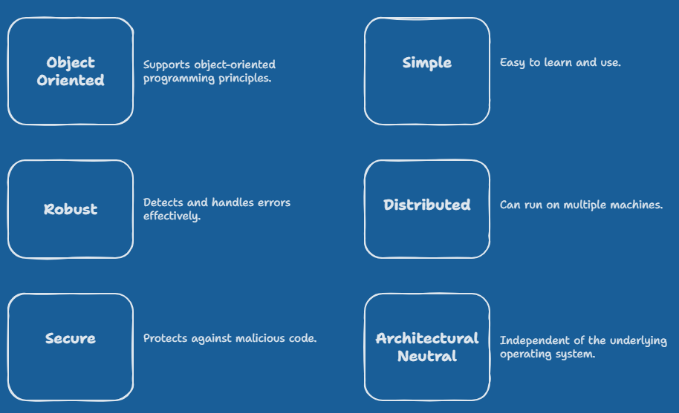
Features of JAVA

Slide 7
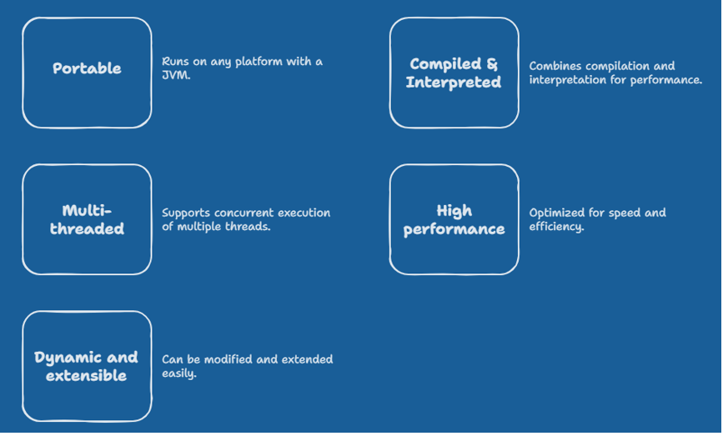
Features of JAVA

Slide 8
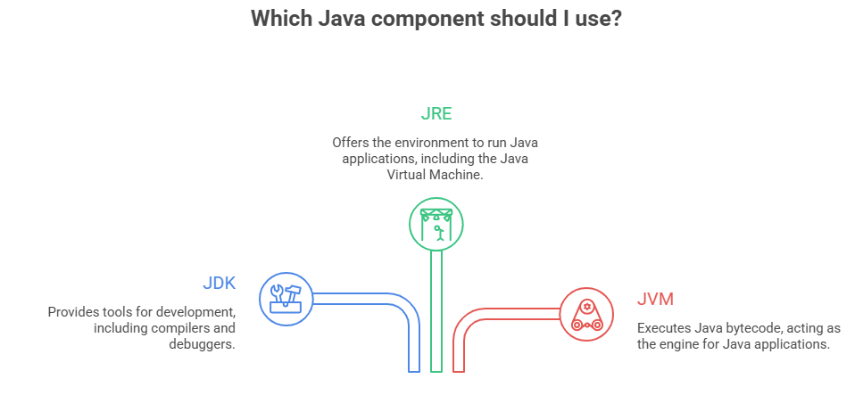
JVM Architecture

Slide 9
JVM Architecture
JVM (Java Virtual Machine) is an abstract machine.
It is a specification that provides runtime environment in which java bytecode can be execute.
A specification where working of Java Virtual Machine is specified. But implementation provider is independent to choose the algorithm. Its implementation has been provided by Sun and other companies.
An implementation Its implementation is known as JRE (Java Runtime Environment).
Runtime Instance Whenever you write java command on the command prompt to run the java class, an instance of JVM is created.

Slide 10
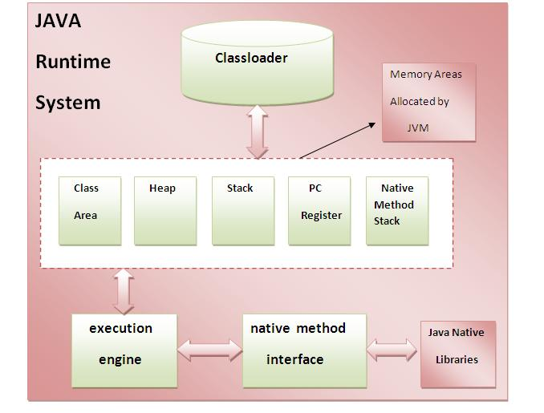
JVM Architecture

Slide 11
JVM Architecture
Loads code
Verifies code
Executes code
Provides runtime environment
JVM provides definitions for the:
Memory area
Class file format
Register set
Garbage-collected heap
Fatal error reporting et

Slide 12
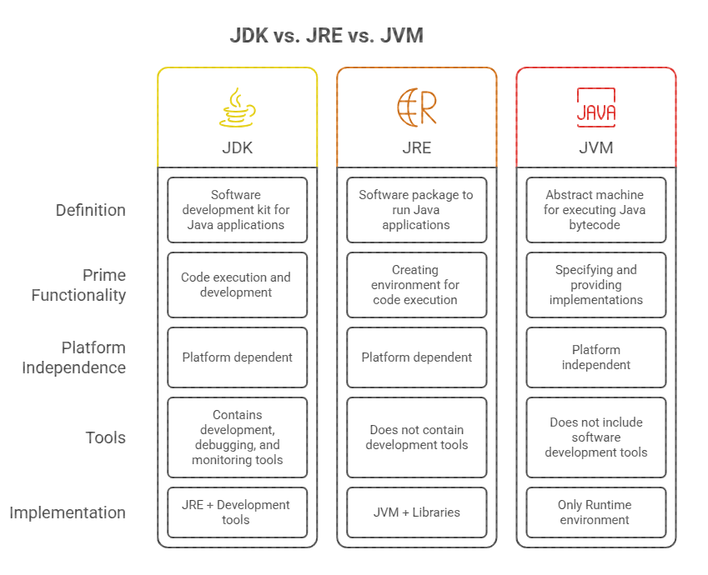

Slide 13
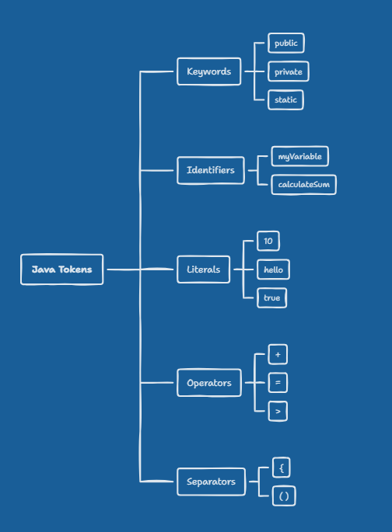
Java Tokens

Slide 14
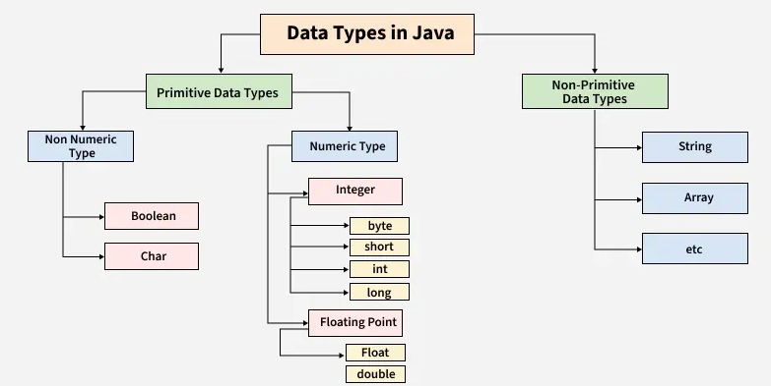
Java Data types

Slide 15
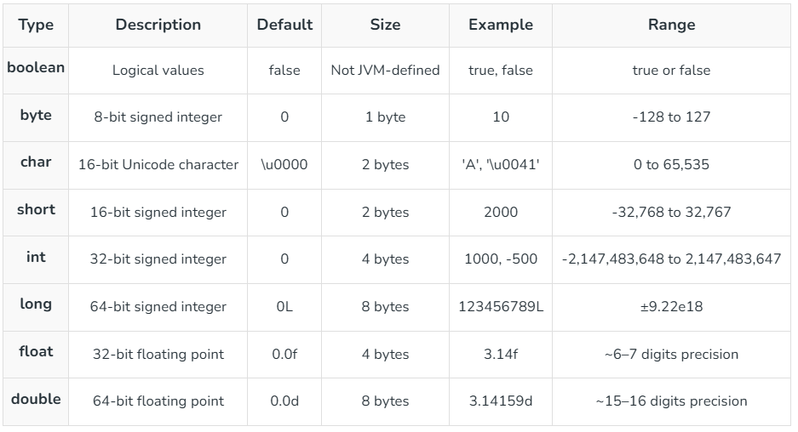
Java Data types

Slide 16
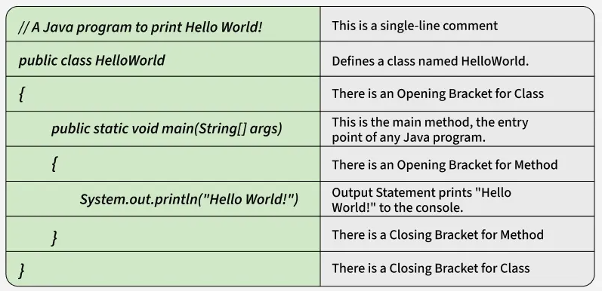
Java programming format

Slide 17
Need of Object Oriented Approach
Software is Inherently Complex
  Impedance mismatch between user of a system and it’s developer.
  Changing Requirements during development.
  Difficulty of managing software development process. It’s a team effort.
  Easy User Interface.
  Clients want systems to be adaptable and Extensible
Notes:
The explanation here is an overview of problems in any s/w development process.
While explaining describe the s/w life cycle( Requirement analysis , design , coding , testing , maintenance )

Slide 18
Object Oriented Approach
The Claim
  Object oriented approach helps to handle the complexity of software development and aids in generation of adaptable and Extensible Systems

Slide 19
Structured Method
Functions
and
Procedures
Data
Object Oriented Method
Object
Object
Object
Object

Slide 20
An object oriented software is composed of discrete objects interacting with each other to give rise to the overall (complex) behavior of the system
- The architecture
Object Oriented Approach

Slide 21

What is an Object ?
An object is an entity that has well defined structure and behavior
Characteristics of an object
      State
  Behavior
  Identity
  Responsibility

Slide 22
State of an Object
The state of an object encompasses the current values of all its attributes. An attribute can be static or dynamic

Slide 23

State of an Object
Car Attributes
Color
Average
Make
Power
Fuel type
Speed
Fuel level
Tyre pressure
Gear
Static
Values of all attributes
at any moment defines
the state of the car
Dynamic

Slide 24
Behavior of an Object
Behavior is how an object acts or reacts, in terms of its state changes and operations performed upon it
Notes:
The behavior can be explained in terms of the same car example before switching to the new example given ahead.

Slide 25
Behavior of an Object
Window Operations
sasaasasasasasasas
Open
Close
Maximize
Minimize
Resize
Move
Write
Totality of operations we can
perform upon a window and
consequent changes in attributes
defines behavior of a window

Slide 26
Identity of an Object
Identity is that property of an object which distinguishes it from all other objects
Notes:
The identity can be explained in terms of the same car example before switching to the new example given ahead.

Slide 27
Identity of an Object
Bank Account
Balance
Interest Rate
Account Number
Customer
IDENTITY
Account number uniquely identifies an account among all others.
A single or group of attributes can be identity of an object.

Slide 28
Responsibility of an Object
The responsibility of an object is the role it serves within the system
Notes:
The responsibility can be explained in terms of the same car example before switching to the new example given ahead.

Slide 29
Bank Account Object
Attributes
Behavior
State
Identity
Responsibility
Balance
Interest
rate
Account
number
Balance=
10000
Interest
rate= 2%
Account
number=
1011
Account
number=
1011
Keeps track of stored
money with the
facility of deposits &
withdrawals
Open
Balance
Withdraw
Report

Slide 30
Examples of Objects
Air
Hard Disk
Pen
Person
Printer
Color
point
Bank Account
Contract
Signal
Industrial Process
Medical Investigation
Transaction
Training Course
An object can be a tangible, intangible or a conceptual entity
Notes:
Make the students write the state , behavior ,identity and responsibility of any of the five objects in the above example.

Slide 31
Class
Class is a template that decides the structure of an object.
Class is a design whereas object is a real entity based on the class.

Slide 32
Object Model- OOP’s Features
5 Major Pillars
  Abstraction
  Encapsulation
  Modularity
  Inheritance
  Polymorphism

Slide 33
Object Model : Abstraction
Abstraction
  Abstraction is the process of identifying the key aspects of an entity and ignoring the rest
  We select only those aspects which are important to us
  Only Domain Expertise can do right abstraction

Slide 34
Object Model
Abstraction of a person object
  Enumerate attributes of a “person object” that needs to be created for developing a database
    useful for social survey
    useful for health care industry
    useful for employment information

Slide 35
Abstraction of a Person Object
Social Survey Health Care Employment
name name name
age age age
marital status --- ---
religion --- ---
income group --- ---
address address address
occupation occupation occupation
--- blood group ---
--- weight ---
--- previous record ---
--- --- qualifications
--- --- department
--- --- job responsibility

Slide 36
Object Model
Real World
Abstraction
Software
{ data, data,….}
attributes
entity
object
behavior
{ method, method,….}

Slide 37
Object Model : Encapsulation
Encapsulation
  Encapsulation serves to separate interface of an abstraction and its implementation
  Encapsulation ensures that data within an object is protected; it can be accessed only by its methods
Notes:
Encapsulation is the process of compartmentalizing the elements of an abstraction that constitute its structure and behavior
The user of the class knows only about its interface; any changes to the implementation does not affect the user

Slide 38
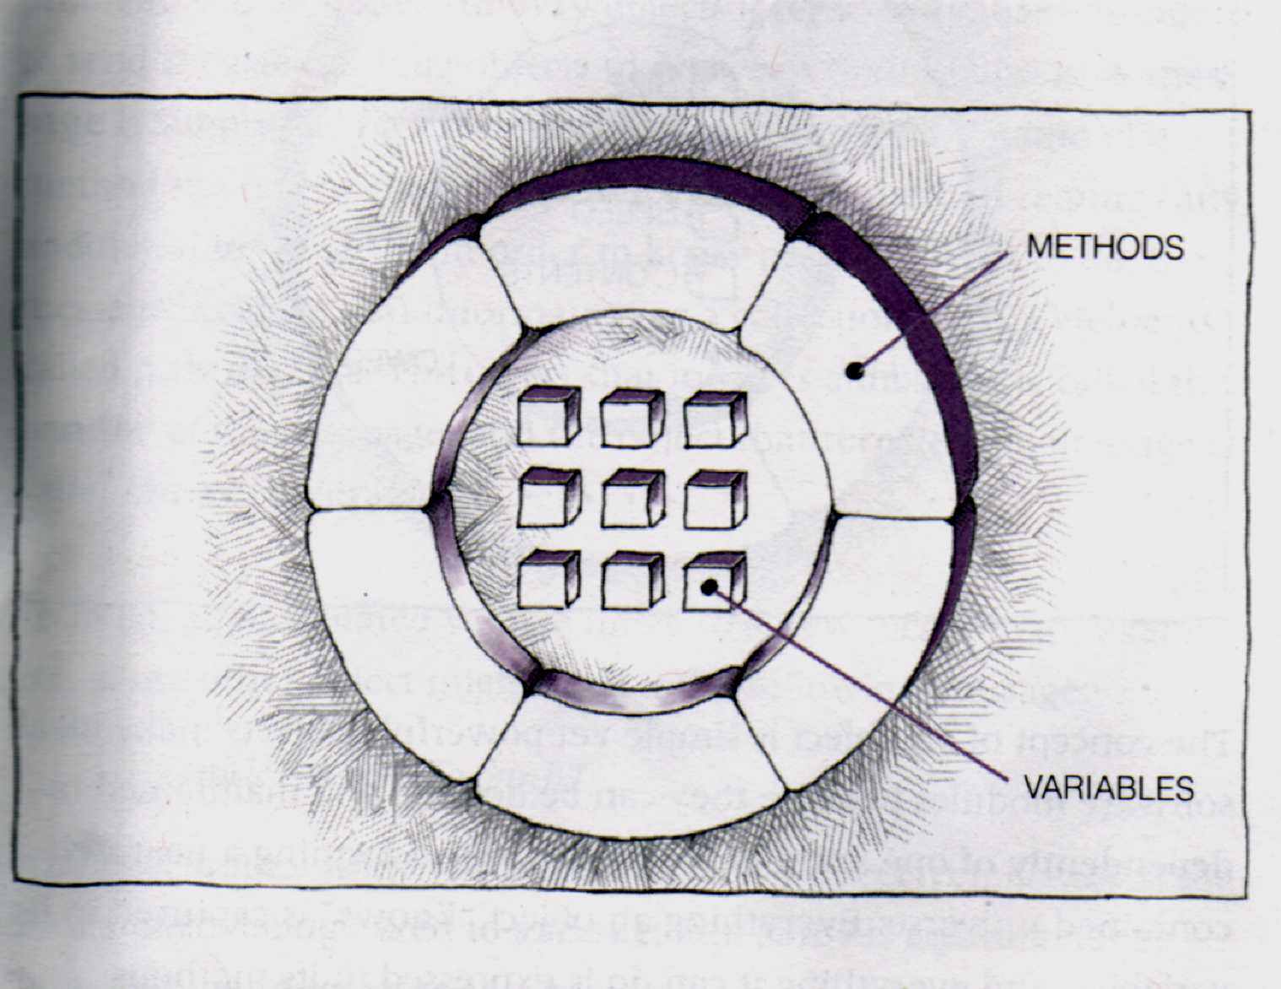
Object Model : Encapsulation
Notes:
For encapsulation give example of car I.e. even if the internal implementation or design of engine is changed the interface given to the car user is the same( the steering wheel , the gear ,the accelerator and brakes).so internal implementation is transparent to the end user.

Slide 39
Object Model: Modularity
Its the process of breaking up a a system into loosely coupled modules that make up a cohesive system.
Eg. Wheel is a inherent part of a car. But a flat tyre can easily be replaced.

Slide 40
Object Model : inheritance
Inheritance
  Classification helps in handling complexity
  Inheritance is a property of a class hierarchy whereby each subclass inherits attributes and methods of its super-class
  The subclass can have additional specific attributes and methods
Notes:
The faculty will talk about inheritance, classification etc.
He then will shift slightly & talk about how inheritance is a type of hierarchy. Therefore, when talking about hierarchies, he will talk about 2 types of hierarchies:
Inheritance
Containment.

Slide 41
Inheritance hierarchy
‘is-a” kind of hierarchy’
Vehicle
2 Wheeler
3 Wheeler
4 Wheeler
Kinetic
Scooter

Slide 42
Inheritance
‘Is a’ kind of Hierarchy
  Generalization and specialization are two points of view that are based on the class hierarchies. They express the direction in which the class hierarchy is extended.
Notes:
Generalization is factoring out common elements within a set of classes into a more general class called super-class. It requires good skills of abstraction.
Specialization requires a depth of experience in particular domain. It allows us to capture specific features of a set of objects

Slide 43
Containment hierarchy
‘has-a’ kind of Relationship
Car
Engine
Chassis
Steering Wheel

Slide 44
Containment hierarchy
Engine
dsa
Insurance
gdfg
Wheels
Registration

Slide 45
Object Model : Polymorphism
Polymorphism
  The ability of different objects to respond to the same message in different ways is called polymorphism
Polymorphism helps us to :
  Design extensible software as we can add new objects to the design without rewriting existing procedures

Slide 46



Polymorphism
Move ( )
Move ( )
Move ( )
Move ( )

Slide 47
Object Model: minor elements
3 Minor Pillars
  Strong Type Casting : prevents mixing of abstraction
  Eg – Bank Slip
  Persistence : saves state of a object across time and space
  Eg – Local object and object that outlive the program
  Concurrency : many objects responding simultaneously.
  Eg typing into a file & printing some previous file at the same time

Slide 48
1. Java does not include c keyword goto, sizeof, and typedef.
2. It does not contain struct,union and enum data types.
3. It does not define modifiers keywords auto, extern, register, signed and unsigned.
4. It does not support explicit pointer type.
5. Java does not have preprocessor and therefore no # define , # include, and # ifdef
6. It does not support any mechanism for defining variable arguments to functions.
7. It requires function with no arguments be declared with empty parentheses and not with void.
8. New operators instanceof and >>>
9. It adds labeled break and continue statements.
10. Java adds many features required for object oriented programming.
Java and c

Slide 49
1. Java does not supports operator overloading.
2. Java does not have template classes as in c++.
3. It does not support multiple inheritance.
4. It does not support global variables.
5. Java does not use pointers.
6. There are no header files in java.
7. Java replaced destructor with finalize() function.
Java and c++

Slide 50
C++
C
java

